Slide 1
Data Types in Java
Rajasekaran S
Assistant Professor,
Department of Information Technology,
KGiSL Institute of Technology,
email: proffraja@gmail.com

Slide 2
Data Types Supported By Java
Data Type
Integer
Float
Character
Boolean
int
float
short
double
long
char
bool
byte

Slide 3
Integer
Type | Storage Required | Range
byte | 1 byte | -128 to 127
short | 2 bytes | -32768 to 32767
int | 4 bytes | -2147483648 to 2147483647
long | 8 bytes | -9223372036854775808 to 9223372036854775807
http://bit.ly/2m0IoFz

Slide 4
Decimal
Type | Storage Required | Range
float | 8 byte | approximately ±3.40282347E+38F (6-7 significant decimal digits)
double | 16 bytes | approximately ±1.797693134862315 0E+308 (15 significant decimal digits)
http://bit.ly/2KJUIZF

Slide 5
Character
Type | Storage Required | Range
char | 2 bytes | 0 to 65,536 (unsigned)
Boolean
Type | Storage Required | Range
bool | - | true or false

Slide 6
Escape Sequence
Escape Sequence | Name
\n | New Line
\b | Backspace
\t | Tab
\r | Carriage Return
\” | Double Quote
\’ | Single Quote
\\ | Backslash

Slide 7
Variables in Java
All variables are statically typed.
You can’t use the variable which is not declared.

Slide 8
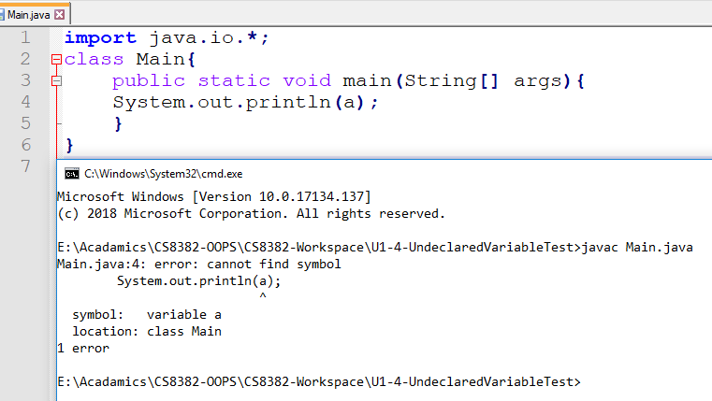
Demo of Undeclared Variable Usage

Slide 9
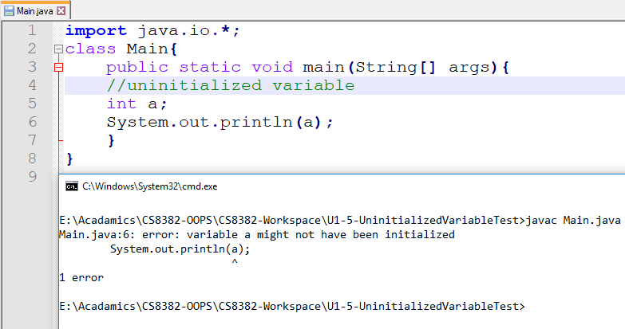
Demo of Uninitialized Variable Usage

Slide 10
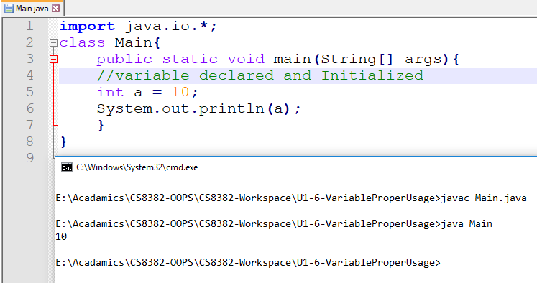
Demo of Proper use of Variable

Slide 11
Constants
Constants are unchangeable variable.
It can be assigned only once.
Then you can’t modify the value.

Slide 12
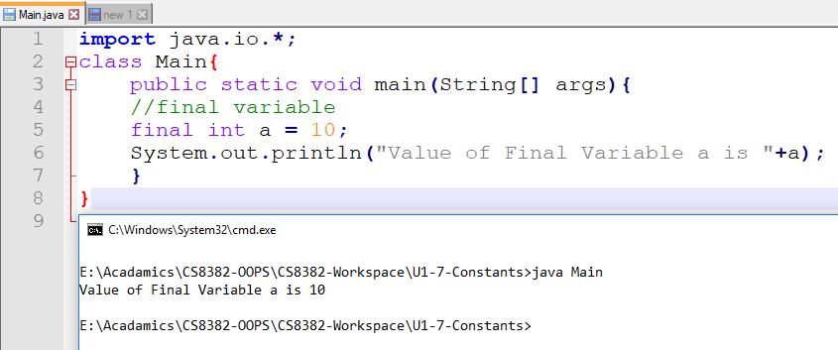
Demo of Final Variable

Slide 13
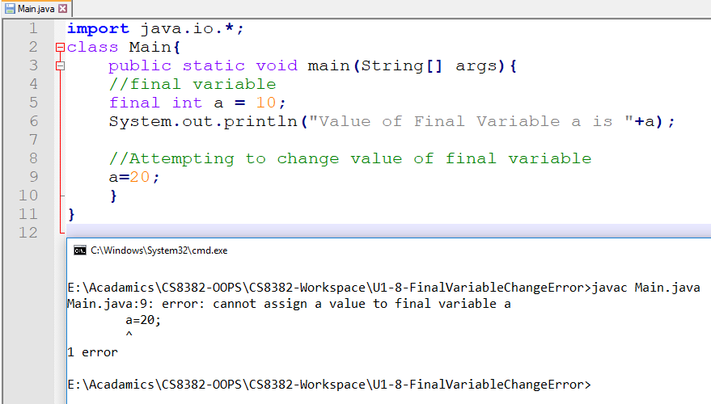
Trying to change final value

